Slide 1
Group Assignment 1
Inverted Index
Team 2: Thanh Le, Antoine Si

Slide 2
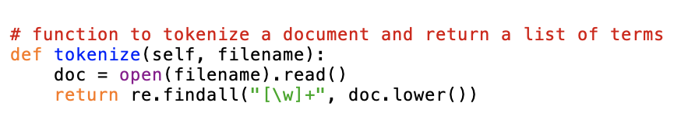
IMPLEMENTATION - TOKENIZATION
Open and read the document
Find and replace all punctuations, numerals, and special characters
Lowercase all the words in the document

Slide 3
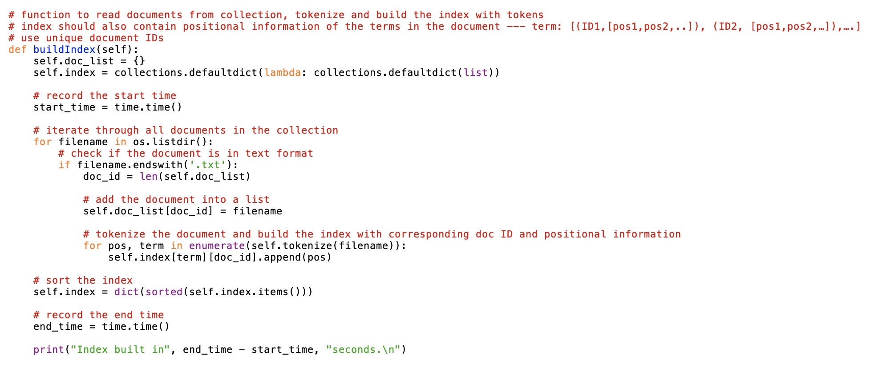
IMPLEMENTATION - BUILDING INDEX
The doc_id of the first document in the collection is 0
The position of the first term in the document is 0

Slide 4
AND MERGE ALGORITHM
Let say we want to merge two posting lists. Following are the steps to be followed to get merge list:
Sort the two posting lists using numeric sort by docID
Maintain pointers into both posting lists and walk through them simultaneously, in time linear in the total number of postings entries.
At each step, compare the docID pointed by both pointers. If they are the same, add that docID into the result list, and advance both pointers. Otherwise, advance the pointer pointing to the smaller docID.
Repeat step 3 until it reaches the end of one posting list
If the lengths of the postings lists are m and n, the merge takes O(m + n) operations.

Slide 5
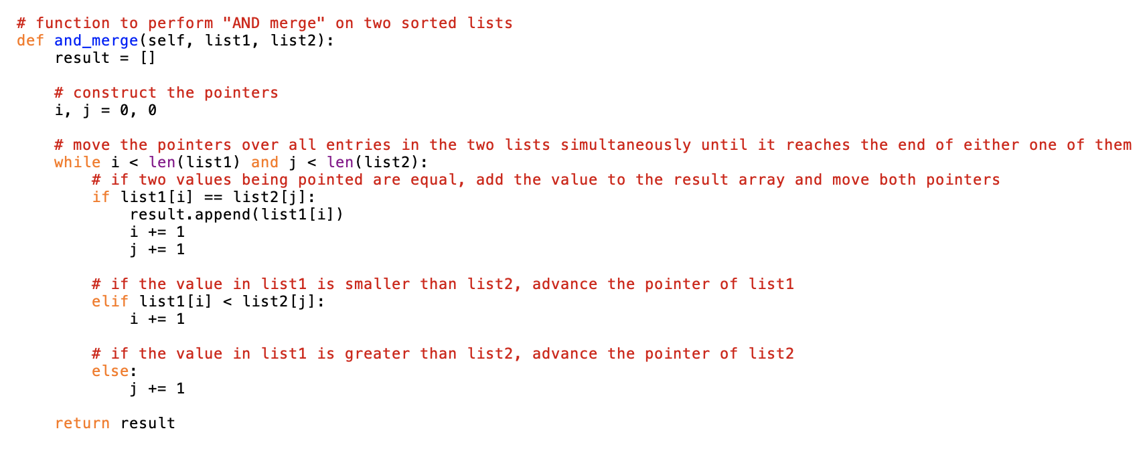
IMPLEMENTATION - AND MERGE

Slide 6
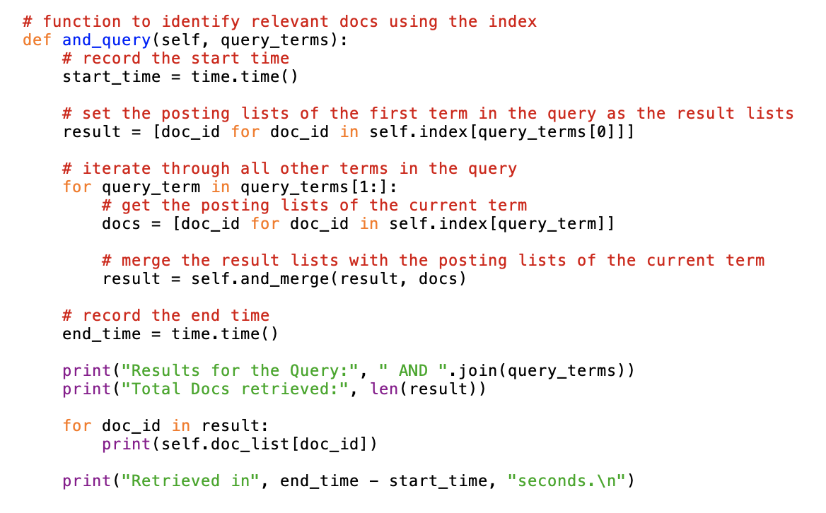
IMPLEMENTATION - AND QUERY

Slide 7
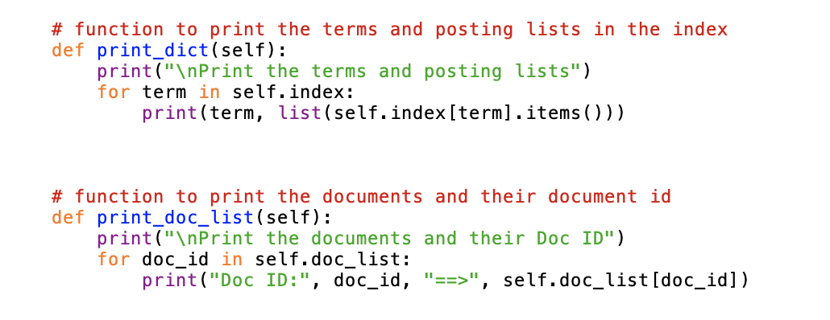
IMPLEMENTATION

Slide 8
EXPERIMENTAL RESULTS
Build the index

Slide 9
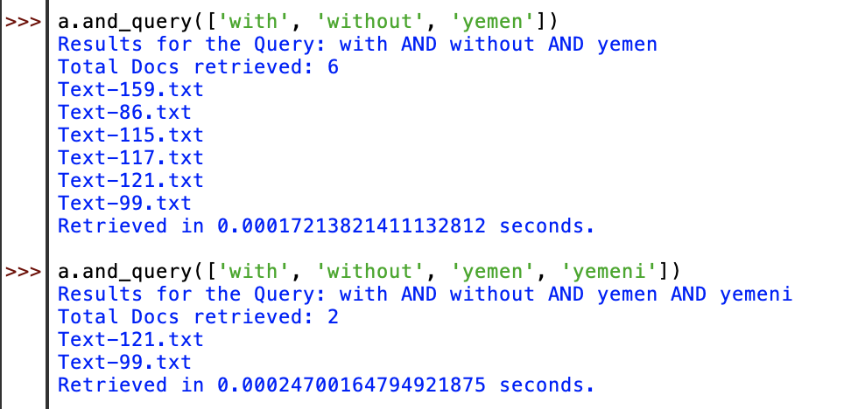
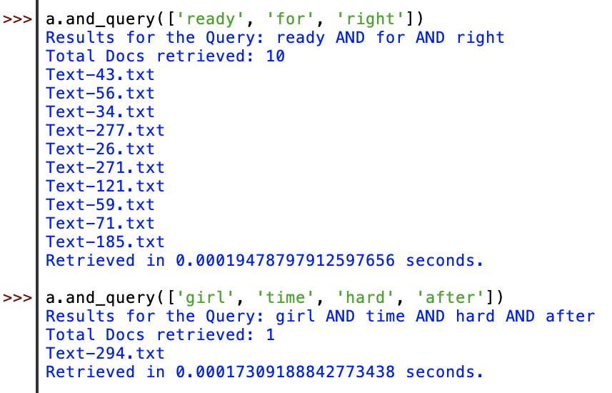
EXPERIMENTAL RESULTS
Process the queries

Slide 10
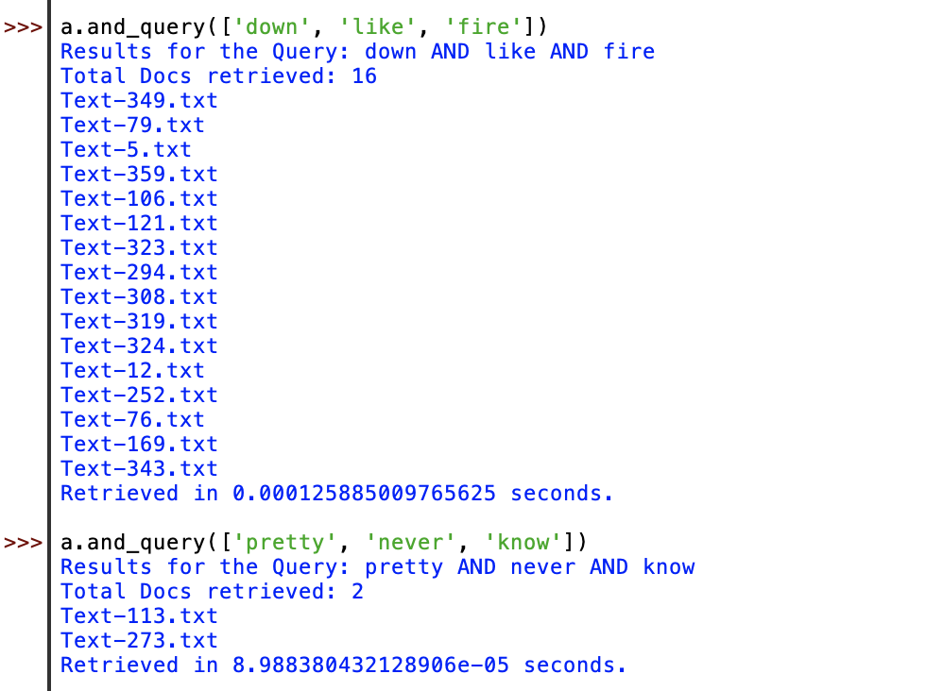
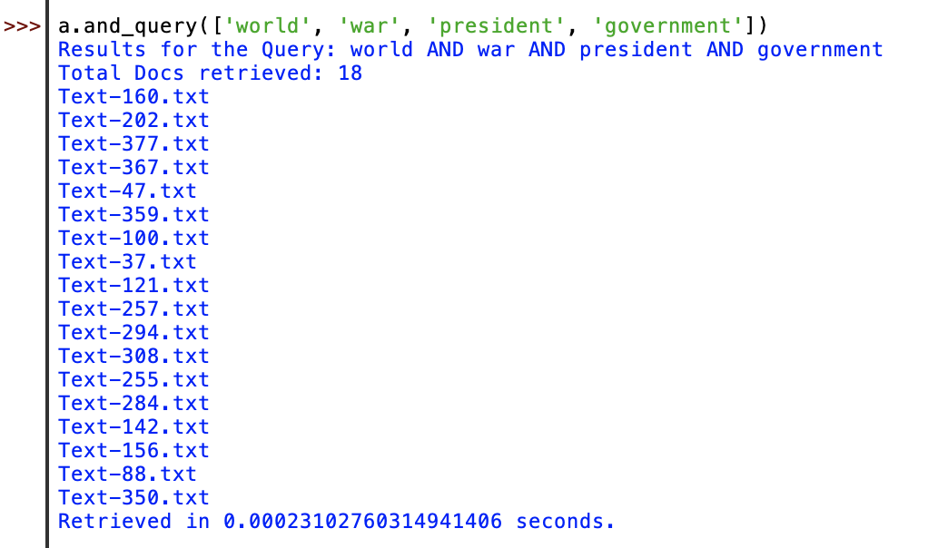
EXPERIMENTAL RESULTS
Process the queries

Slide 11
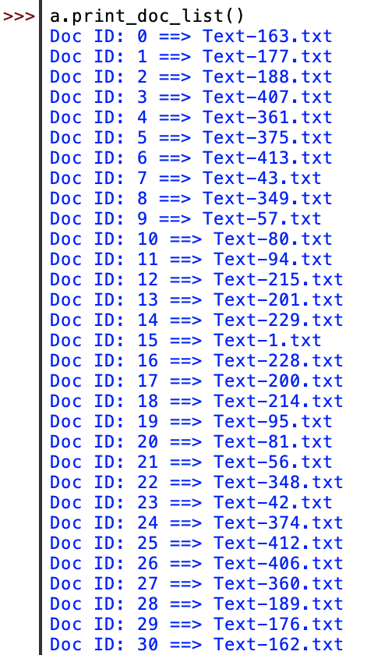
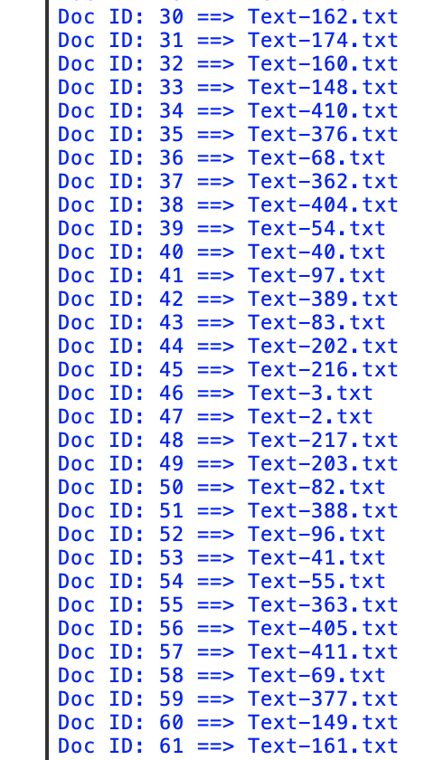
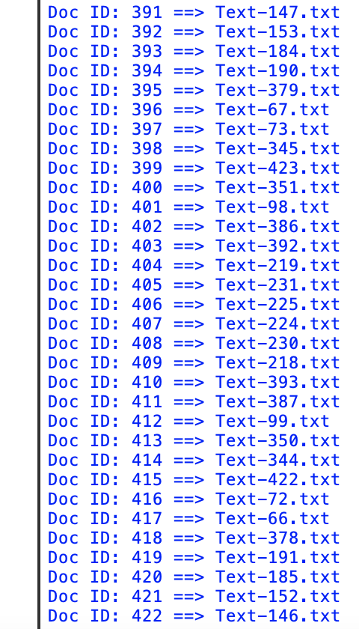
EXPERIMENTAL RESULTS
Print out the documents with their Doc IDs
…

Slide 12
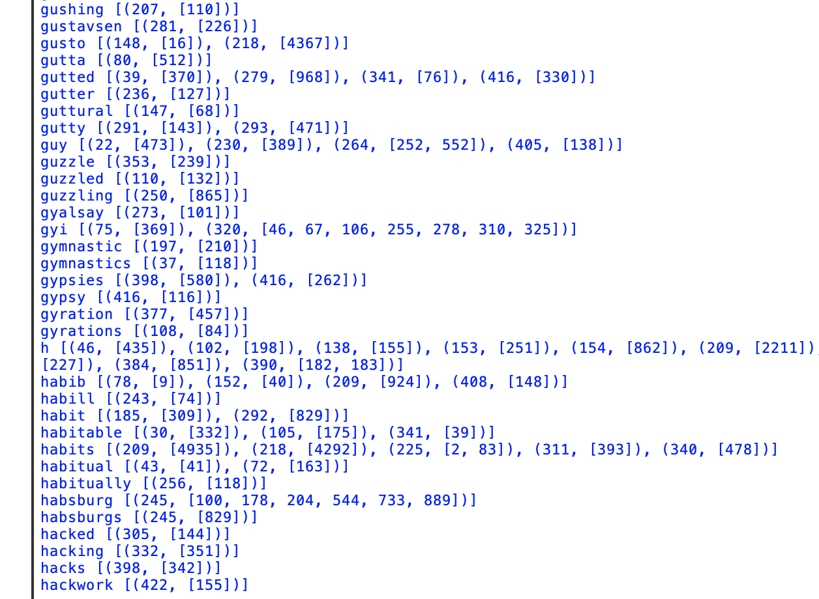
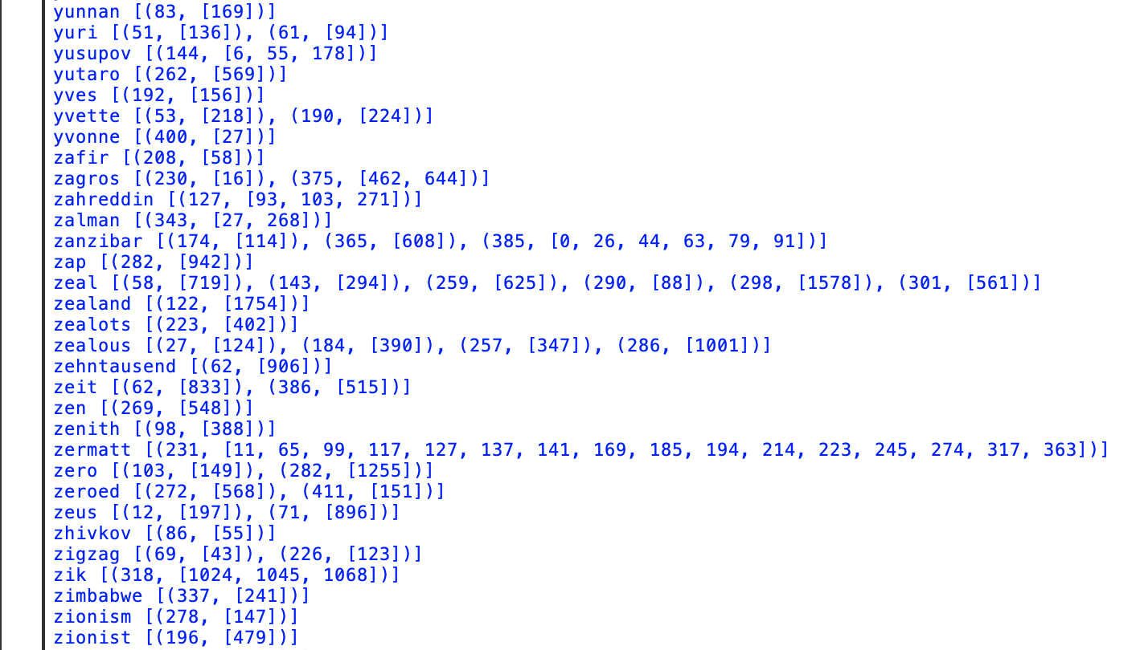
EXPERIMENTAL RESULTS
Print out the terms with posting lists

Slide 13
TASK DIVISION
Both of us first started working on implementing the index.py file by ourselves and discussed with each other when any problem happened
We compared our query results with each other to make sure we got the same outputs
We combined our works into a final version with detailed comments in each step which helps explaining the codes
Thanh created the README file
Antoine created the output.txt file
We worked on the presentation slides together

